Slide 1
Chapter 10-Subprograms (part 1)
Subprogram 101
Jihene Kaabi & Youssef Harrath

Slide 2
Indirect Addressing (1)
So far, we have seen one way to address the content of memory.
Define a symbol, i.e., an address in the .bss or .data segments. L dd FA123BDEh
Use that symbol as an address so that we can access content. mov eax , [L]
L is an address in memory and [L] is the content of whatever is stored at that address.
We have also used registers to store addresses
mov eax , L ; eax stores the address
inc eax ; modify the address
mov bx, [eax] ; put the 2 bytes starting at address ; eax into bx

Slide 3
Indirect Addressing (2)
Registers can hold “data” or “addresses.”
Not keeping this straight leads to horrible bugs.
The processor will happily apply whatever operation on whatever data as long as data sizes are correct.
E.g., if you think that a register contains an integer, but in fact it stores the address of the integer in memory, then your arithmetic operations on that integer will return very strange results.
Since addresses are 32-bit, only EAX, EBX, ECX, EDX, ESI and EDI registers can be used to store addresses in a program.

Slide 4
What is a subprogram?
A subprogram is a piece of code that starts at some address in the text segment.
The program can jump to that address to “call” the subprogram.
When the subprogram is done executing, it jumps back to the instruction after the call, and the execution resumes “as if nothing had happened.”
The subprogram can take parameters.

Slide 5
Subprogram: example
We want to write a subprogram that computes some numerical function of two operands and “returns” the result.
We will write the subprogram so that when it is called, the first operand is in eax, the second in ebx, and when it returns, the result is in eax.
Calling the subprogram can then be done via a simple jmp instruction.

Slide 6
“By hand” subprogram (1)
mov eax, 12
; first operand = 12
mov ebx, 14
; second operand = 14
jmp func ; “call” the function ret:
func:
add eax, ebx ; do something with eax and ebx
; put result in eax
jmp ret
; “return” to the instruction
; after the call

Slide 7
“By hand” subprogram (2)
mov eax, 12
; first operand = 12
mov ebx, 14
; second operand = 14
jmp func ; “call” the function ret:
Why is this not really a subprogram?
func:
add eax, ebx ; do something with eax and ebx
; put result in eax
jmp ret
; “return” to the instruction
; after the call

Slide 8
Multiple Calls
Typically, we want to call a function from multiple places in a program.
The problem with the previous code is that the function always returns to a single label.
jmp func ; “call” the function
ret1:
jmp func ; “call” the function
ret2:
func:
jmp ??? ; where do we return???

Slide 9
A Better Function Call (1)
To fix the previous example, we need to remember the place where the function should return.
This can be done by storing the address of the instruction after the call in a register, say, ecx.
The code for the function then can just return to whatever instruction ecx points to.
This is a convention that we decide and that we must remember.

Slide 10
Better Function Call (2)
mov ecx , ret1 ; store the return address
jmp func ; “call” the function
ret1:
mov ecx , ret2 ; store the return address
jmp func ; “call” the function
ret2:
func:
jmp ecx ; return

Slide 11
All Good, but …
So, at this point, we ca do any function call.
We just need to decide on and document a convention about which registers hold the
input parameters,
return value, and
return address.
The problem is that this gets very large
It requires a bunch of “ret” labels all over the code.
It forces the programmer to constantly keep track of registers and be careful to save and restore important values.
Solution:
A stack
Two new instructions: CALL and RET

Slide 12
The Stack
A stack is a Last-Out data structure. It provides two operations
Push: puts something on the stack
Pop: removes something from the stack
Defined by the address of the “element” at the top of the stack, which is stored in the so-called “”stack pointer.”
Push: puts the element on top of the stack and updates the stack pointer.
Pop: gets the element from the top of the stack and updates the stack pointer.
The processor has “tools” (registers, instructions) to maintain one stack.
It is called the “”runtime stack”

Slide 13
The Runtime Stack
We assume that the stack will only allow pushing/popping of 4-byte elements.
The stack pointer is always stored in the ESP register.
Initially, the stack is empty, and the ESP register has some value.
The stack grows downward (i.e., toward lower addresses).
Pushing an element
Decreases ESP by 4 and writes 4 bytes at addresses ESP
E.g., push eax push dword 42
Popping an element
Gets the value from the top of the stack into a register and increases ESP by 4
E.g., pop eax pop edx

Slide 14
Stack Instructions: Example (1)
■ Assuming that ESP=00001000h
push dword 1
; ESP = 00001000h – 4h = 00000FFCh
1 dword 00 00 00 01h
00000001
Decreasing addresses
00000FFCh
Stack status

Slide 15
Stack Instructions: Example (2)
■ Assuming that ESP=00001000h
push dword 1
; ESP = 00001000h – 4h = 00000FFCh
push dword 2
; ESP = 000000FFCh – 4h = 00000FF8h
00000002
00000001
Decreasing addresses
00000FF8h
00000FFCh
Stack status

Slide 16
Stack Instructions: Example (3)
■ Assuming that ESP=00001000h
push dword 1
; ESP = 00001000h – 4h = 00000FFCh
push dword 2
; ESP = 000000FFCh – 4h = 00000FF8h
push dword 3
; ESP = 000000FF8h – 4h = 00000FF4h
00000003
00000002
00000001
Decreasing addresses
00000FF4h
00000FF8h
00000FFCh
Stack status

Slide 17
Stack Instructions: Example (4)
■ Assuming that ESP=00001000h
push dword 1
; ESP = 00001000h – 4h = 00000FFCh
push dword 2
; ESP = 000000FFCh – 4h = 00000FF8h
push dword 3
; ESP = 000000FF8h – 4h = 00000FF4h
00000003
00000002
00000001
pop eax ; eax = 3h
Decreasing addresses
00000FF4h
pop ebx ; ebx = 2h
00000FF8h
00000FFCh
pop ecx ; ecx = 1h
Stack status

Slide 18
PUSHA and POPA
For subprograms, a key use of the stack is to save/restore register values.
Say your program uses eax and calls a function written by somebody else.
You have no idea whether that function uses eax.
The x86 offers two convenient instructions
PUSHA: pushes EAX, EBX, ECX, EDX, ESI, EDI and EBP onto the stack.
POPA: restores them all and pops the stack.
It’s now simple to say, “save all my registers” and “restore all my registers.”

Slide 19
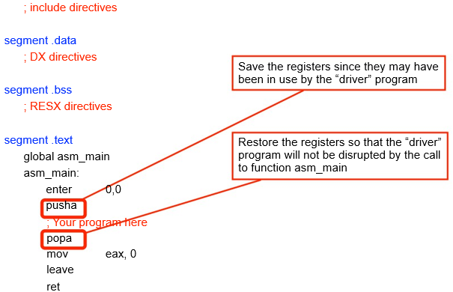
Recall the NASM Skeleton (1)

Slide 20
The CALL and RET Instructions
One of the annoying things with our previous subprogram was that we had to manage the return address.
In our example, we stored it into the ECX register. Two convenient instructions can manage the return address.
CALL
Pushes the address of the next instruction on the stack
Unconditionally, jumps to a label (calling a function)
RET
Pops the stack and gets the return address
Unconditionally, jumps to that address (returning from a function).

Slide 21
Without CALL and RET
mov ecx, ret1 jmp func
; store the return address ; “call” the function
ret1:
mov ecx, ret2 jmp func
; store the return address ; “call” the function
ret2:
func:
jmp ecx
; return

Slide 22
With CALL and RET
call func
; call the function
call func
; call the function
func:
ret
; return
Looks almost like high-level code

Slide 23
Recall the NASM Skeleton (2)
; include directives
segment .data
; DX directives
segment .bss
; RESX directives
segment .text
global asm_main
asm_main:
Returns from function asm_main
enter 0,0 pusha
; Your program here
popa
mov eax, 0 leave
ret

Slide 24

In-class Exercise
Write a program that
prompts the user to enter two numbers by calling a subprogram
prints back the entered numbers, and
calculates and print their sum.
Sample output:

Slide 25
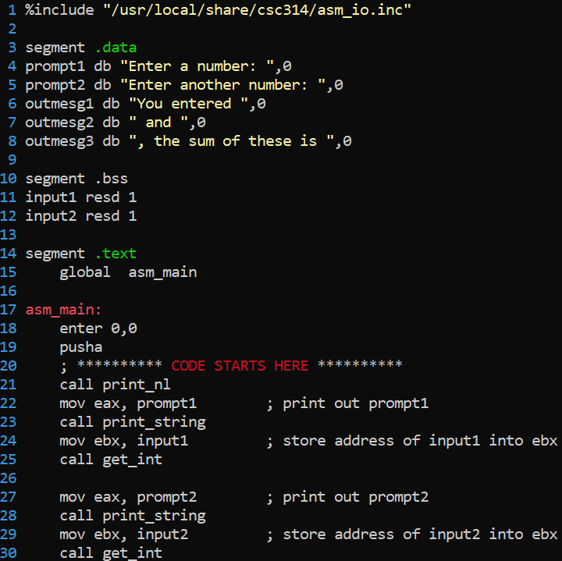
In-class Exercise: Solution (1)

Slide 26
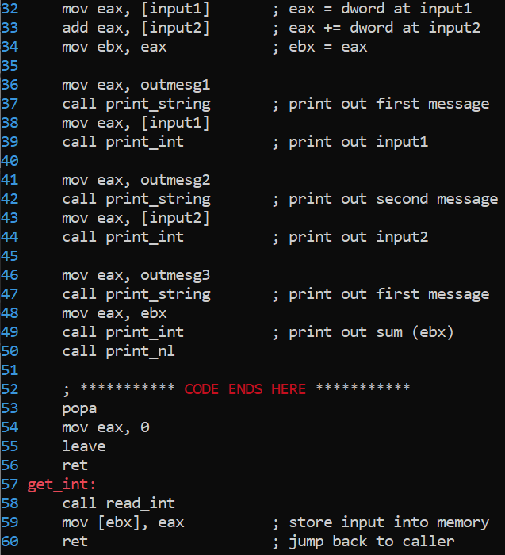
In-class Exercise (2)

